Slide 1
Drowsiness Detection

Slide 2
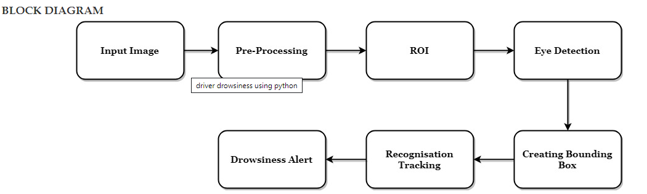
Architecture Diagram

Slide 3
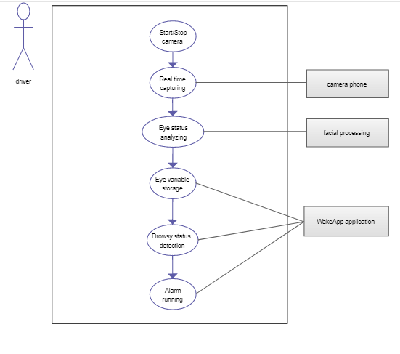
Use case diagram

Slide 4
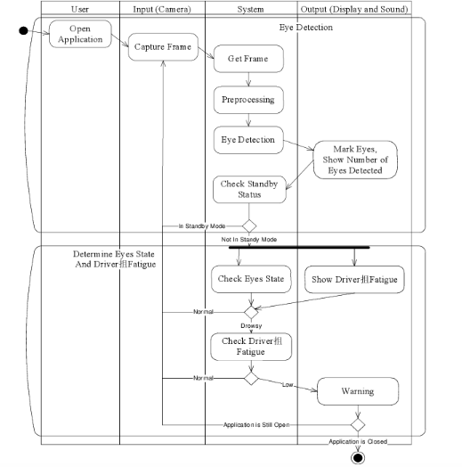
Sequence Diagram

Slide 5
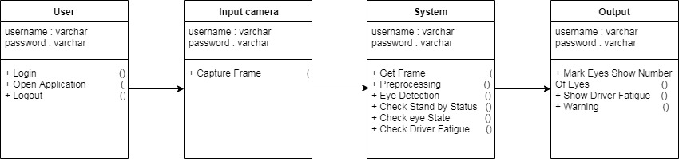
Class Diagram

Slide 6
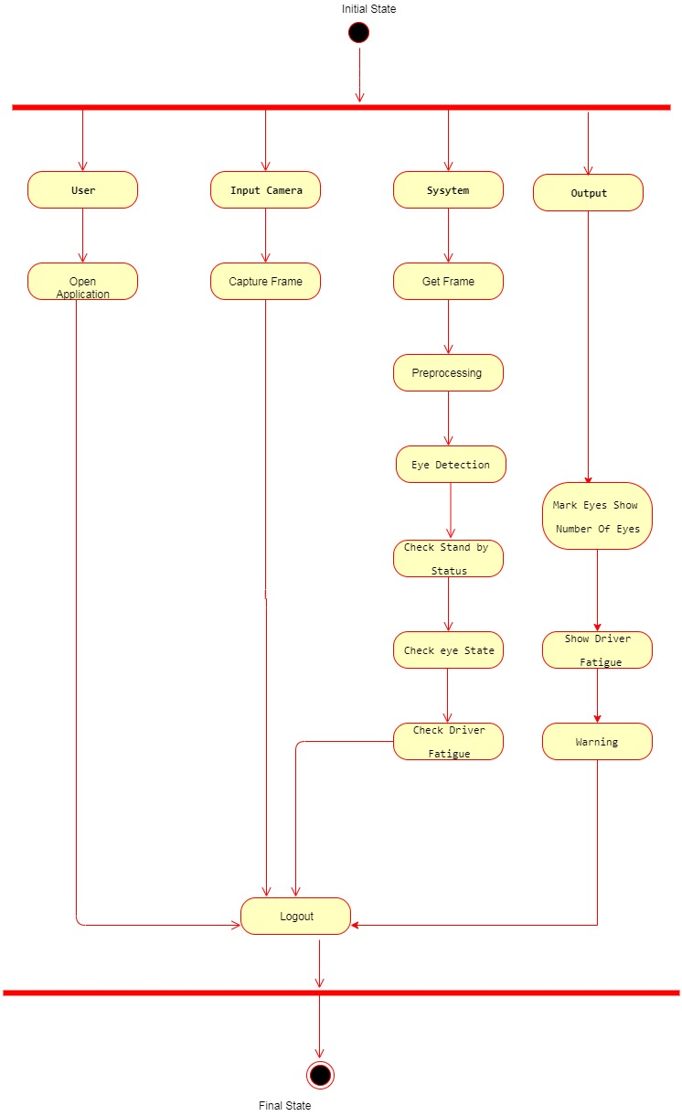
Activity Diagram

